Slide 1
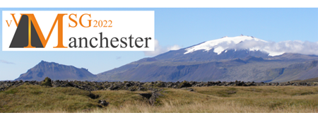
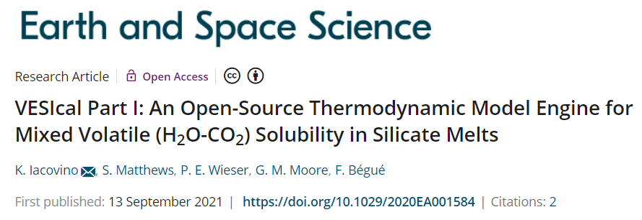
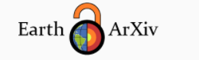
VESIcal workshop!
Simon Matthews and Penny Wieser
Team VESIcal I and II: Kayla Iacovino, Simon Matthews, Penny Wieser, Gordon Moore, Florence Begue, Chelsea Allison
Penny Wieser, Kayla Iacovino, Simon Matthews, Gordon Moore, Chelsea Allison

Slide 2
The practical exercises will take place on “the cloud”. Go to:
vesicalworkshop.simonwmatthews.com
Log in NOW, or sign-up (it is not too late!)
Introduction to Solubility Modelling (Penny)
Introduction to Python (Simon)
EXERCISE 1: Jupyter Notebooks + Python (Simon)
A history of Solubility Models (Penny)
EXERCISE 2: Using VESIcal (Simon)
Comparing Solubility Models (Penny)
EXERCISE 3: Batch Calculations (Simon)
Evaluating Solubility Model Differences (Penny)
EXERCISE 4: Degassing Calculations (Simon)
Uncertainties in Saturation Pressure Calcs (Penny)
EXERCISE 5: Sensitivity Tests (Simon)
Conclusions (Penny)
Q&A (Penny & Simon)
Need Help? Have Questions? Put them in the chat and we will help you ASAP!

Slide 3
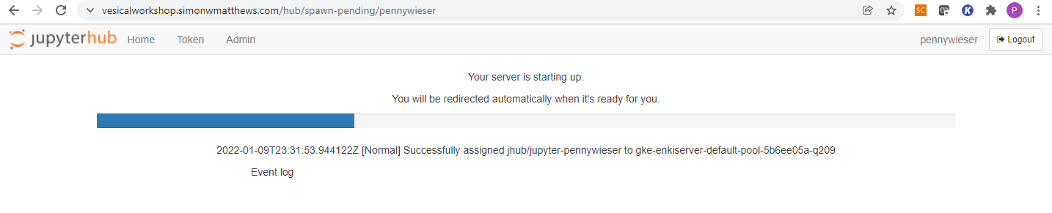
Lets all login to the server!
Notes:
vesicalworkshop.simonwmatthews.com

Slide 4
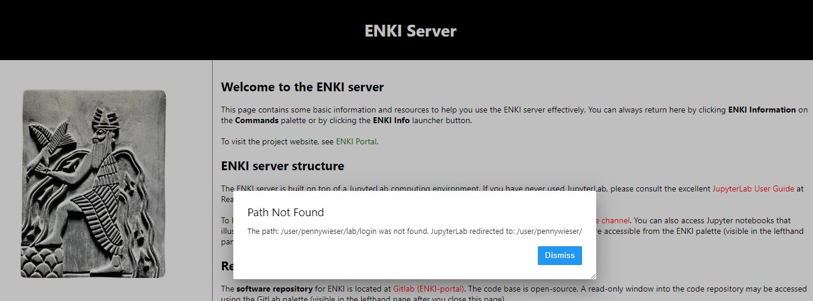
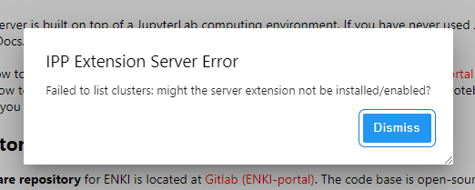


Slide 5
VESIcal workshop!
Simon Matthews and Penny Wieser
Team VESIcal I and II: Kayla Iacovino, Simon Matthews, Penny Wieser, Gordon Moore, Florence Begue, Chelsea Allison
Penny Wieser, Kayla Iacovino, Simon Matthews, Gordon Moore, Chelsea Allison

Slide 6
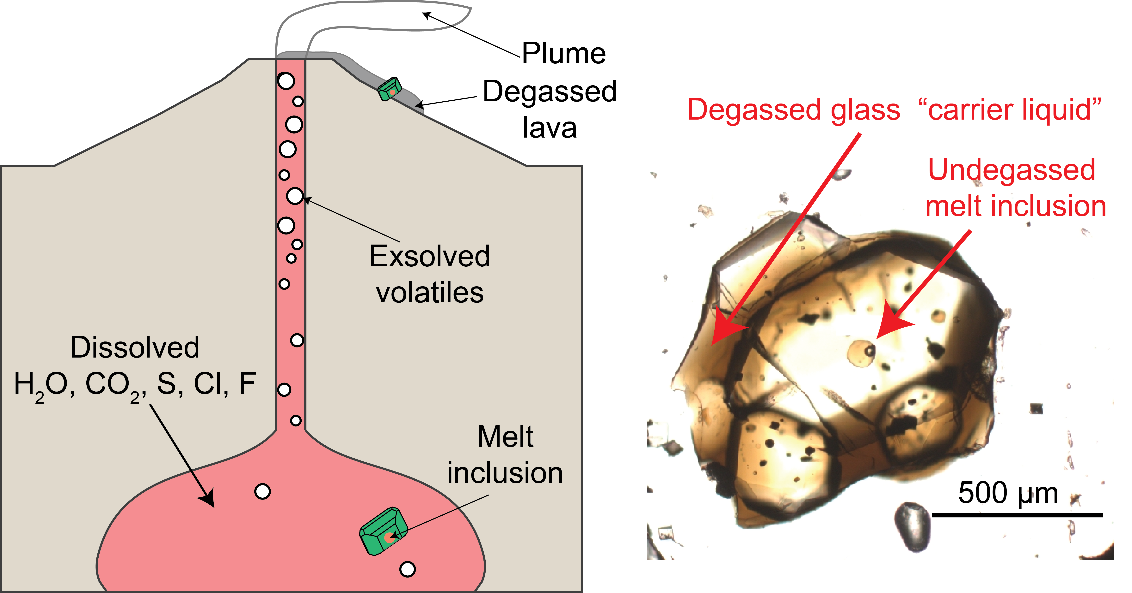
Use 1: Storage depths from melt inclusions
Notes:
Discuss main use – i.e. melts degassed at surface, so need pockets of melt inside crystals, that have been more resistant to volatile loss.

Slide 7
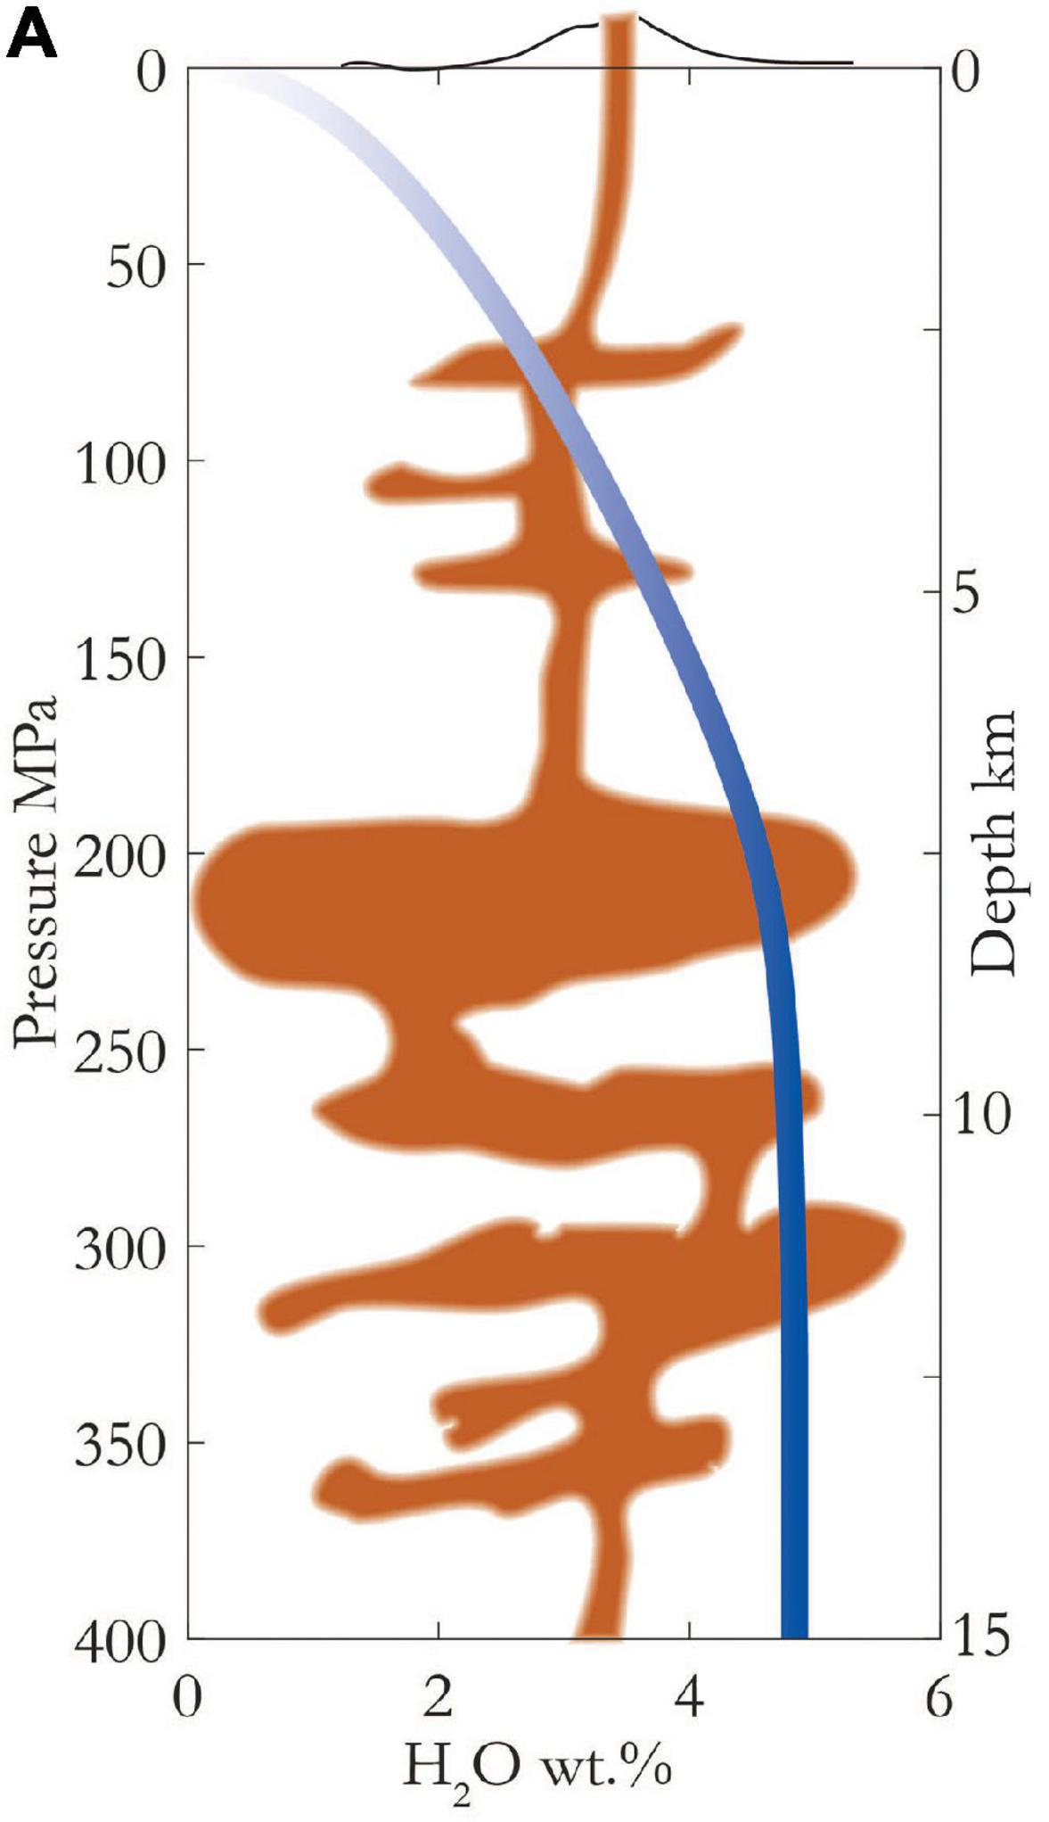
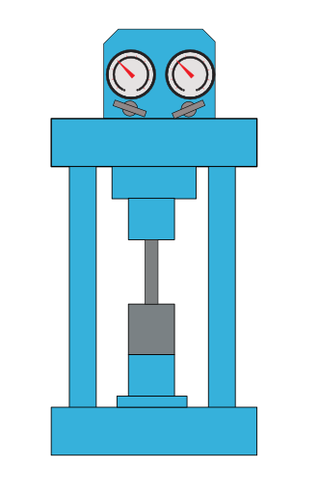
Use 2: Calculating dissolved volatiles
Amount of dissolved volatiles in saturated experiments
Barth and Plank, 2021
Notes:
Discuss main use – i.e. melts degassed at surface, so need pockets of melt inside crystals, that have been more resistant to volatile loss.

Slide 8
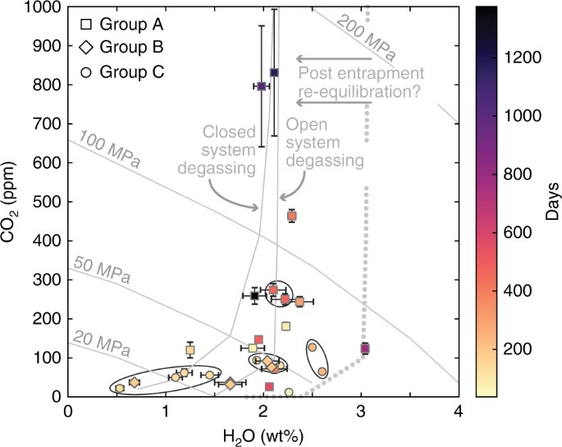
Use 3: Calculating degassing paths and isobars
Ruth et al. 2018
Notes:
Discuss main use – i.e. melts degassed at surface, so need pockets of melt inside crystals, that have been more resistant to volatile loss.

Slide 9
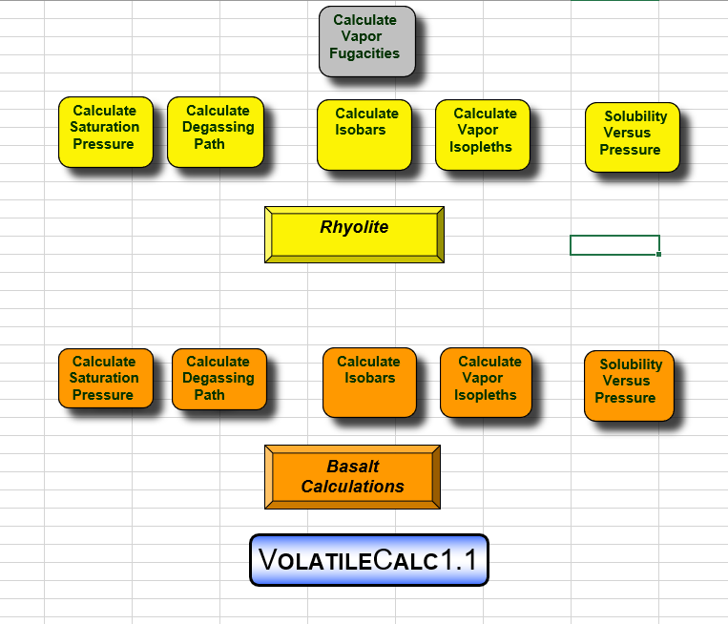
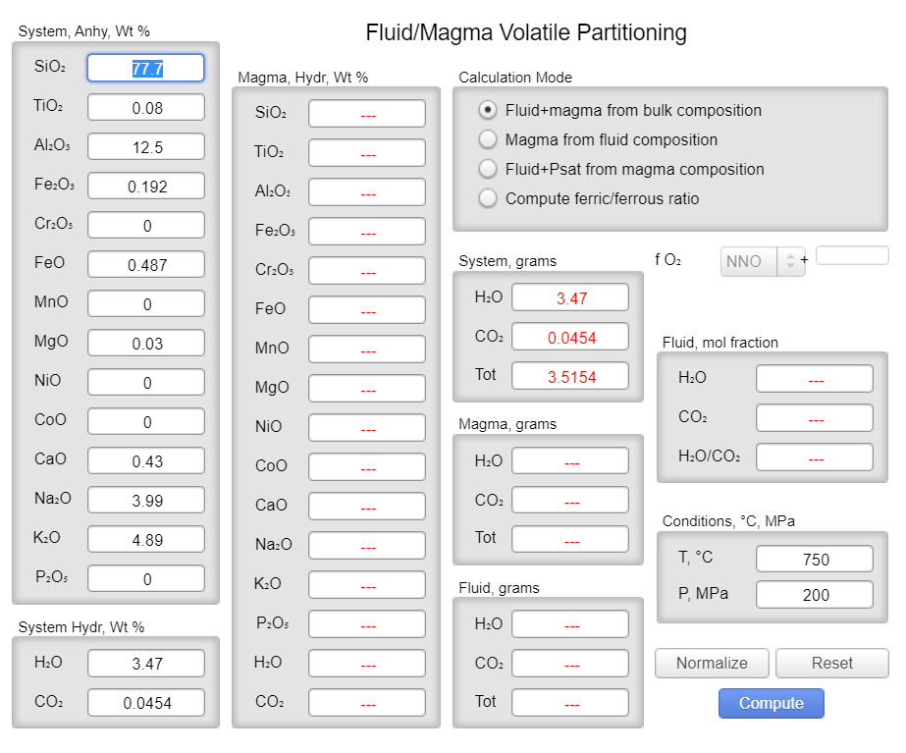
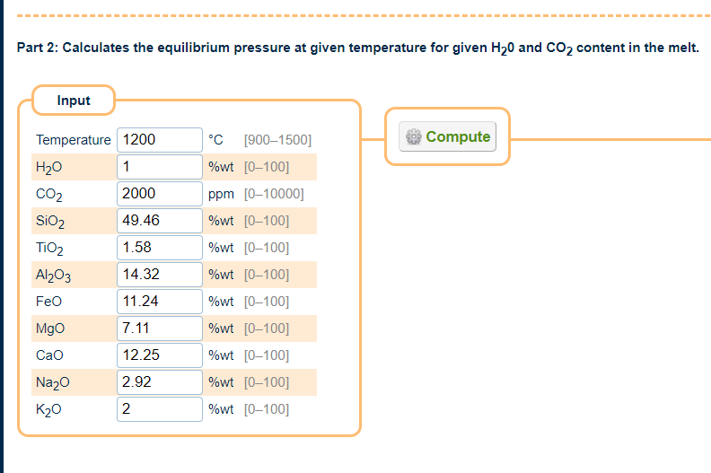
Previous tools to perform calculations
VolatileCalc-Basalt – Most popular option
(Newman and Lowenstern, 2002)
Ghiorso and Gualda, (2015)
MagmaSat Web App
Iacono-Marziano et al. (2012)
Web App
Put zoom
box here!

Slide 10
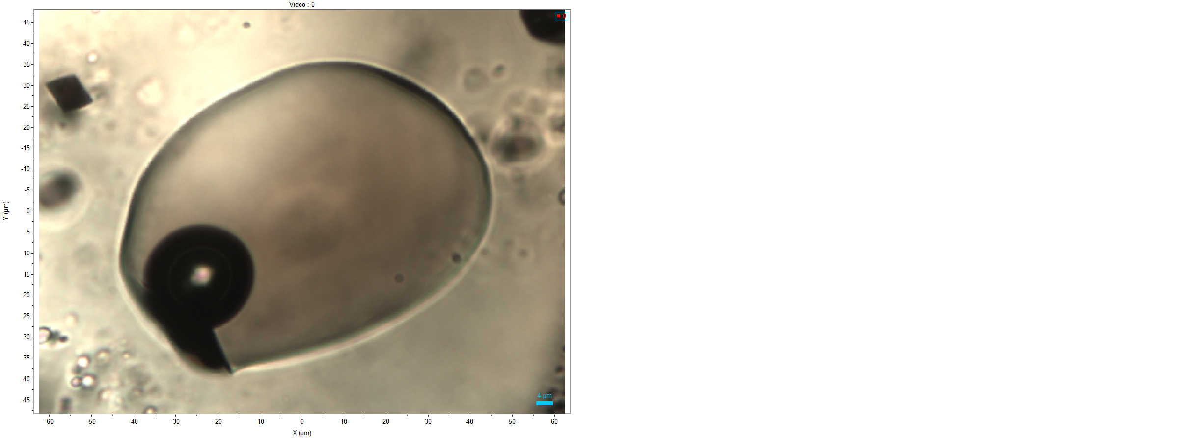

Calculating Saturation Pressures
VolatileCalc – SiO2, Temp, H2O, CO2
More recent models = 8-9 oxides, Temp, H2O, CO2
N=103 from Fissure 8
103*12 = 1236 hand-typed inputs!
Put zoom
box here!
For just 1 model!

Slide 11
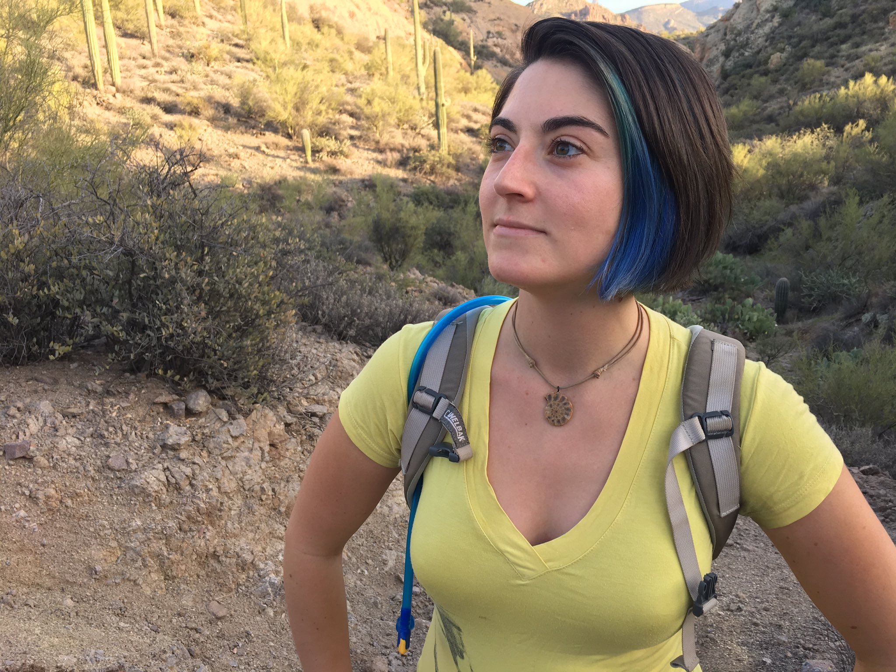

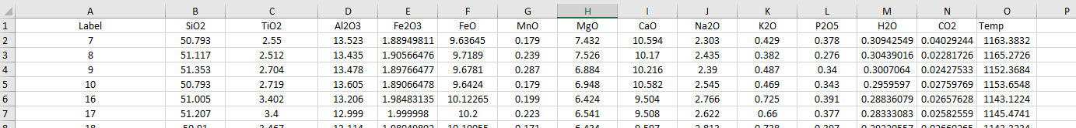
VESIcal - An Open-Source Python3 Approach
Put zoom
box here!
VESIcal part I – Kayla Iacovino, Simon Matthews,
Penny Wieser, Gordon Moore, Florence Begue
Earth and Space Science 2021

Slide 12

Why (did we make VESIcal in) python?
Programming Language
Way of writing instructions for a computer to follow- e.g., for telling a computer how to do things
Widely Used (in science + beyond)
LOTS of (scientific) tools (and help to use them) available
Powerful
If a computer can do it then python can tell it how!
Free & Open Source
Anyone can use it, and everything is (in principle) totally transparent
Why Open Source?
Transparent- you can see exactly what goes into the results!
Encourages collaboration- let us know if you want to add a feature or you spot a bug!
No re-inventing the wheel

Slide 13
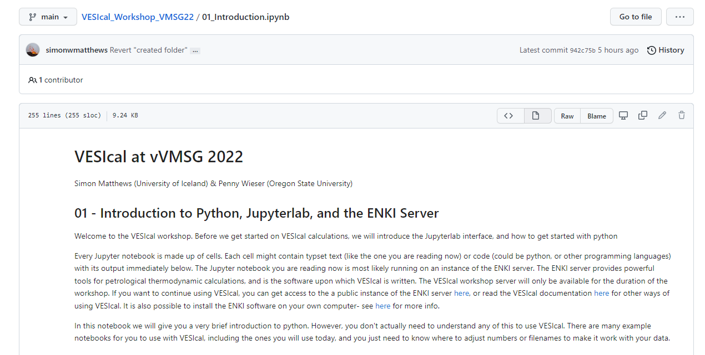
Lets hand over to Simon for an introduction to Python

Slide 14
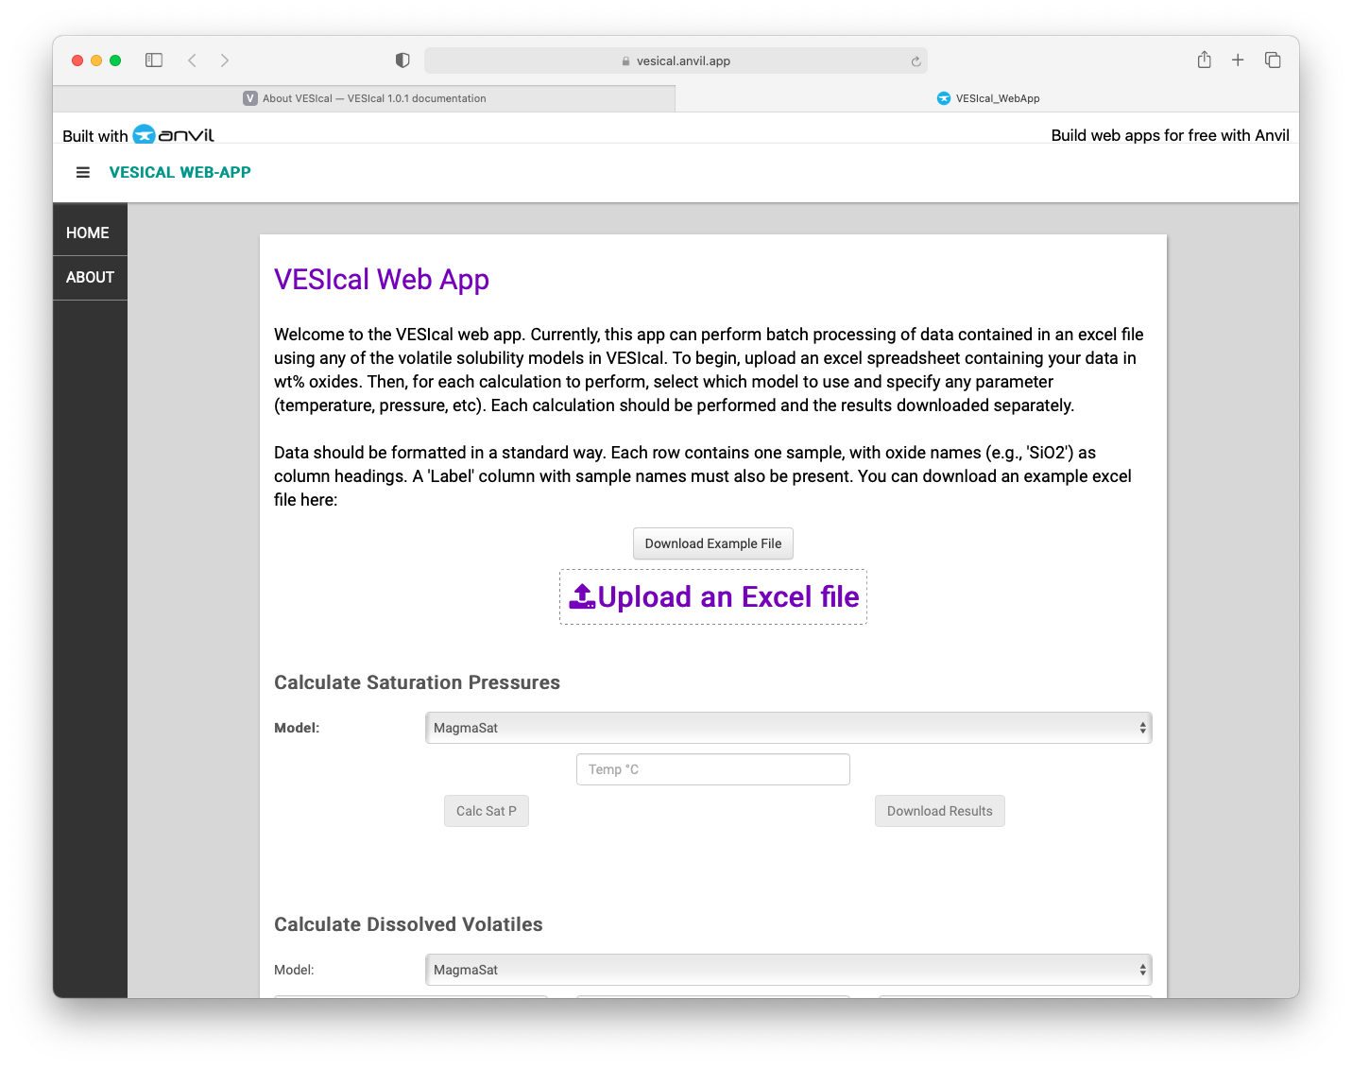
But why not use (VESIcal through) a GUI/text interface?
Limits you to doing the calculations the author has thought of
Python modules let you interact with individual bits of the calculation, modify them, and do innovative things
Often interfaces prevent you from seeing the underlying code (by design or accident)
Not good for transparency and reproducibility! Leads to reinventing the wheel!
But… you can build GUIs on top of python! vesical.anvil.app

Slide 15
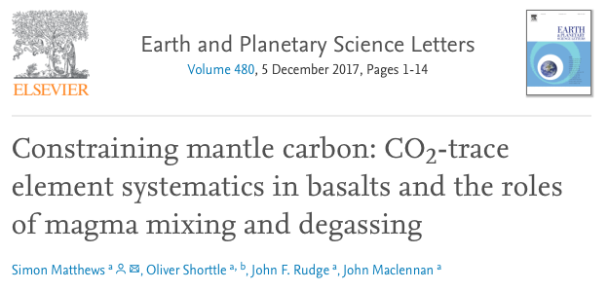
Is this flexibility useful?
Hopefully our workshop will convince you it is!
In VESIcal Part II Penny uses this flexibility to interrogate properties of the models in a way that it would have been impossible (or very tricky) to do before!
String other python packages together!
Add new models just by defining their properties- don’t need to re-write code for calculations.
pyMelt
(github.com/simonwmatthews/pyMelt)
Mantle Melting
(& CO₂ in primary melts)
CO₂ contents of melts during storage + degassing
VESIcal
(well, its predecessor)
Statistical Mixing Module
(github.com/simonwmatthews/dirichlet_mixing)
Melt mixing and the statistics of melt inclusion populations

Slide 16
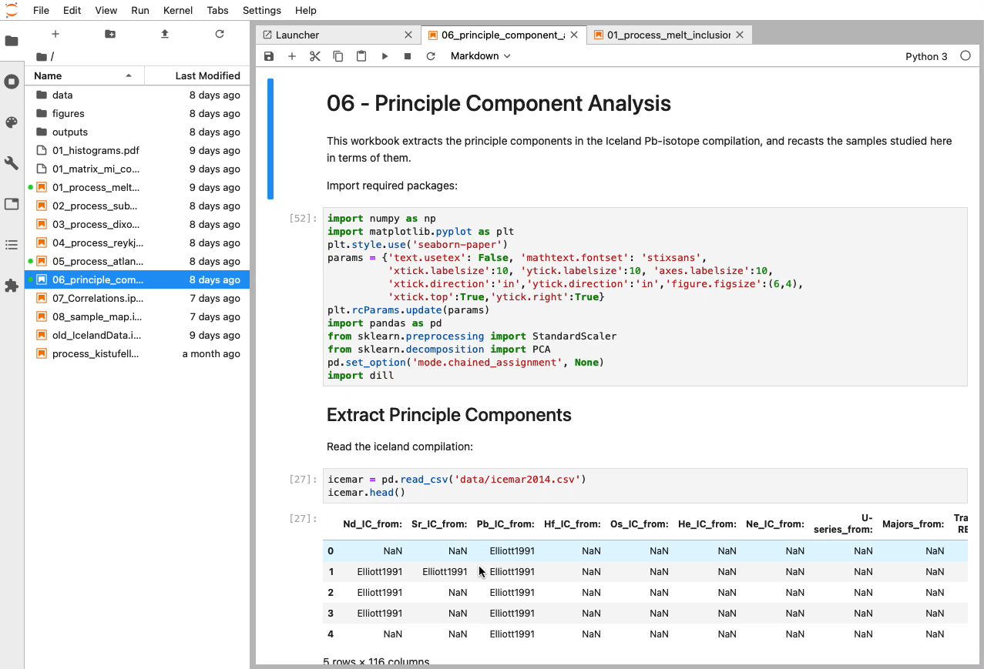
Jupyter Notebooks
Lots of ways to interact with with python (and VESIcal)
We recommend using Jupyter Notebooks! We will use these during the workshop.
Fantastic tool for open and reproducible science!
+ convenient to use

Slide 17
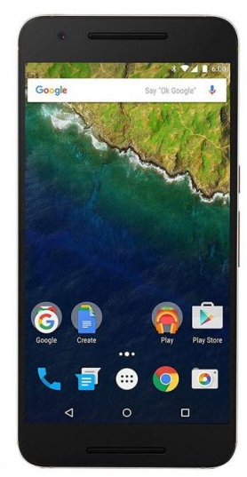
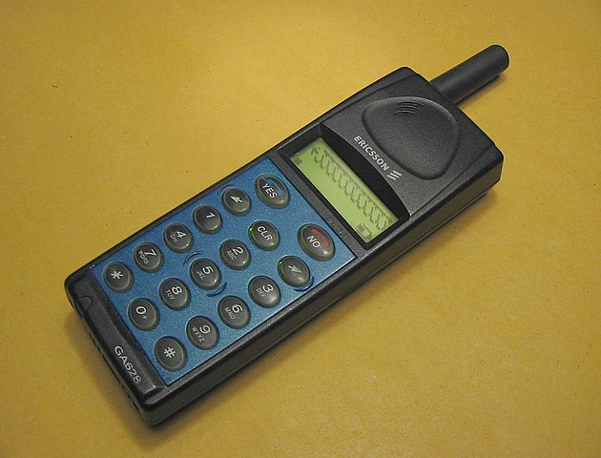
A brief history of solubility modelling

Slide 18


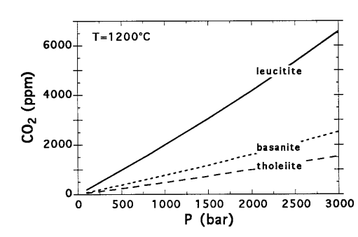
Experimental work links H2O+CO2 to Pressure…
1. Known melt composition
3. Controlled fluid composition (ideally….)
2. Known T and P
4. Empirical or thermodynamic relationship developed
Dixon (1997)
Notes:
Relies on experiments, take melt composition, control T, P and XH2O, look at solubility vs species. Ie. Seminal work of Dixon, shows controlled by P and melt composition.

Slide 19
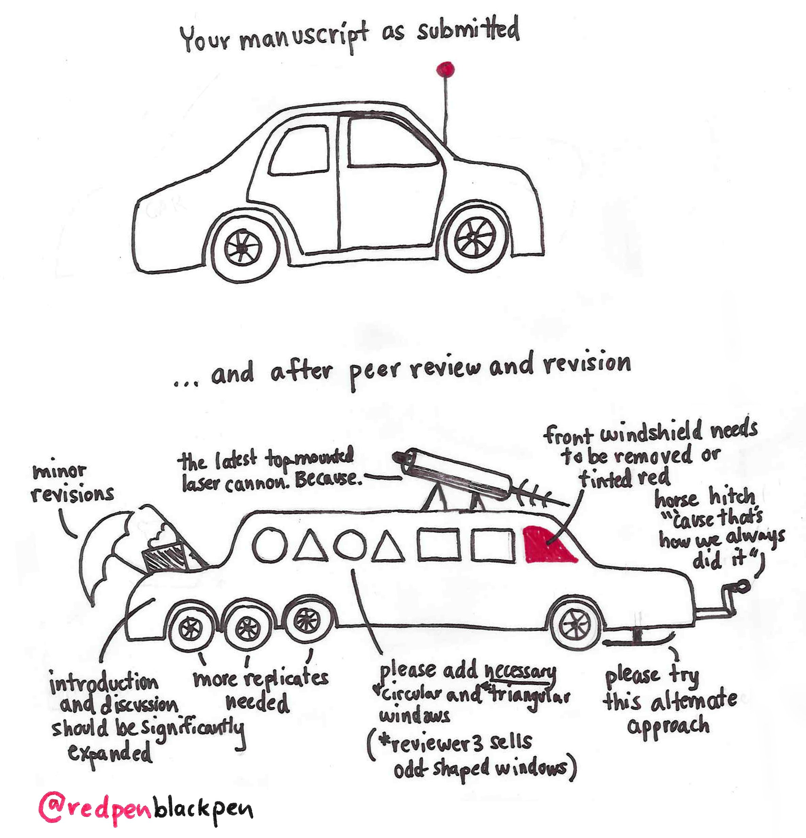
Solubility models
Volatile solubility models in the 80-90s
Volatile solubility models in the 2000s onwards
Non-ideality
More
Thermodynamic
Complex terms
for melt composition
Other fluid
species
Notes:
Evolution of solubility models like this peer review for a car – In the 80s and 90s, extremely simple computationally. Have had to add in other terms, i.e. realizing H2O and CO2 interact, in highly non ideal ways, as compositional dataset expands, had to include more melt terms, have become more thermodynamic as have more computational ability, and still frontiers being addressed, e.g., other fluid species.

Slide 20
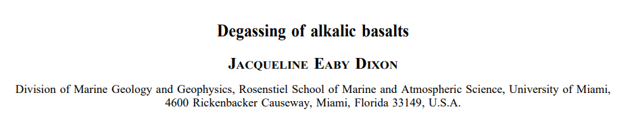
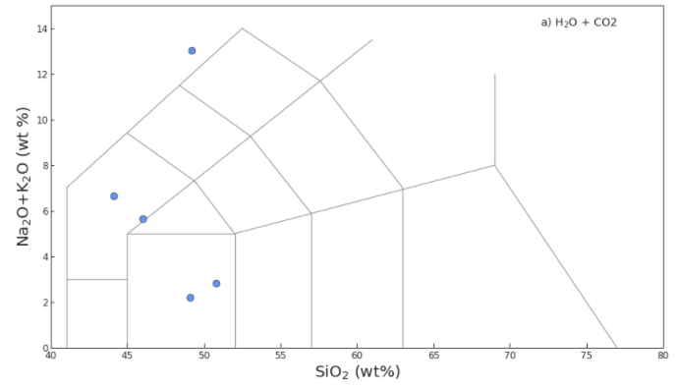
A brief history of solubility modelling: 1997
1997
Notes:
Go through history – and for comparisoin, I’m showing the most popular cell phone the year the model was released. Jackie Dixon, 5 varyingly alkali basalts.

Slide 21
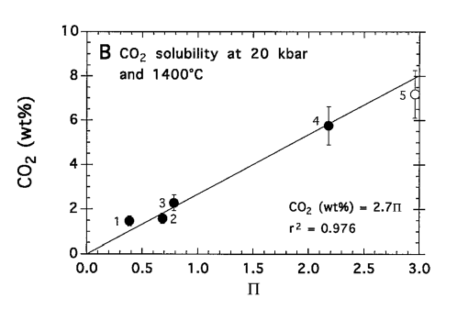
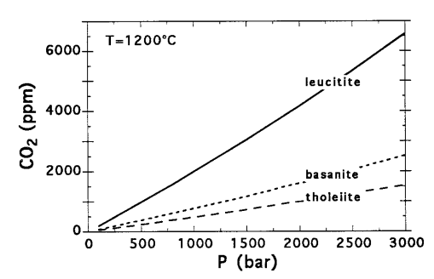
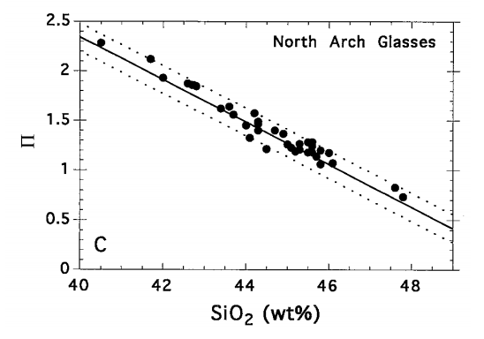
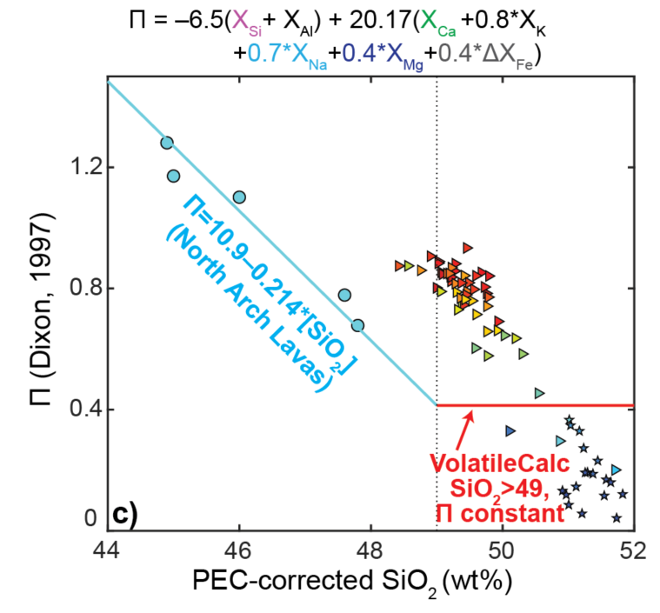
A brief history of solubility modelling: 1997
4to 5 varying alkaline basaltic compositions
Notes:
Jackie shows CO2 solubility is a function of melt composition at a given pressure. Shows that CO2 solubility is a function of this Pi parameter. Cation fractions of these species. But she simplified this model for application to the north arch volcanic field. Showed Pi correaltes with Si content, so instead of having to calculate Pi, can use SiO2 as a proxy.

Slide 22
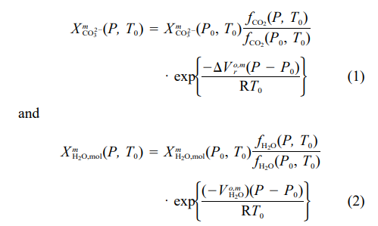
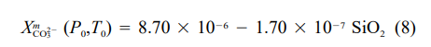
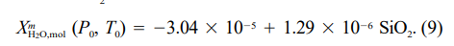
A brief history of solubility modelling: 1997
Thermodynamic part
Empirical correction for
melt composition
From Dixon et al. (1995)
Notes:
So in 1995, Jackie took a model from various work by Silver and Stolper, looks at solubility of carbonate ion and water. Has no melt composition term, just various thermodynamic, P and T terms. In 1997, she updated this model by calculating these X terms as a function of SiO2 content, to add a term for melt composition. So as you add more SiO2, amount of carbonate ion dissolves goes down. As add more Si, water solubility goe sup.

Slide 23
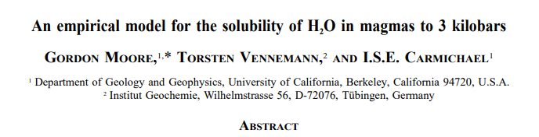
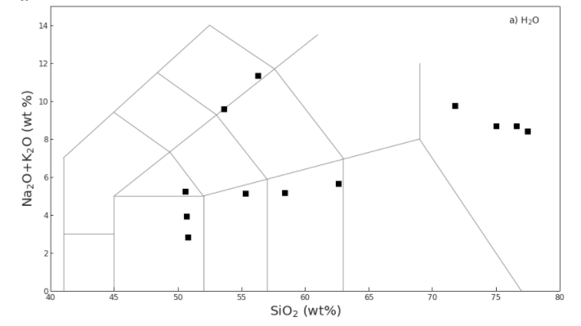
A brief history of solubility modelling: 1998
Notes:
A year later, Gordon Moore comes along, does experiments on a much wider range of compositions, from basalt to rhyolite. Just looking at H2O solubility.

Slide 24
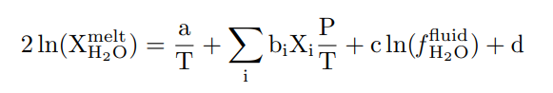
A brief history of solubility modelling: 1998
Empirical correction for
melt composition
Notes:
Much simpler model than Dixon, none of those nasty thermodynamic terms. Have dissolved water as a function of temp, with a P/T term that appears in lots of models, and a fugacity of water. Means even though Gordon doesn’t model CO2, can combine with models that do like Dixon, to get a mixed fluid model. Has this empirical term, so a constant times by fractions of oxide in the melt.Unlike Dixon, uses 3 oxides (Al-Fe-Na) not just Si.

Slide 25
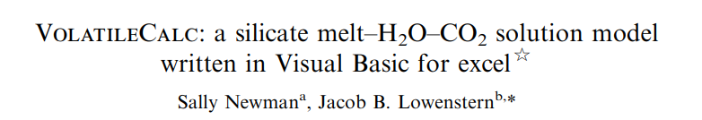
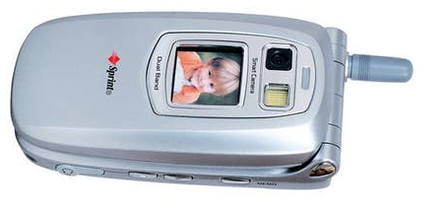
A brief history of solubility modelling: 2002
1997
2002
1st Camera phone!
Basalt – Dixon 1997
Rhyolite CO2 – Stolper et al., 1987,
Fogel and Rutherford, 1990, Silver et al. 1990,
Blank et al. 1993.
Rhyolite H2O – Dixon 1995-like, Silver 1988, 1990.
Notes:
By 2002, have a great increase in technology, have 1st flip and camera phone. Simplified models of Dixon were incorporated into the excel spreadsheet volatile calc. Has nice click buttons, basalt model uses that simplified SiO2 relationship. Rhyolite model is a combination of varying models from Stolper, fogel and rutehrfod, and blank. Has no melt composition term. Basalt asks for a Si content, rhyolite just asks for P and T.

Slide 26
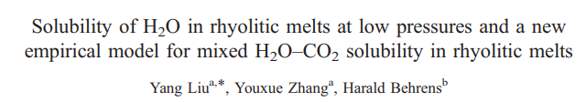
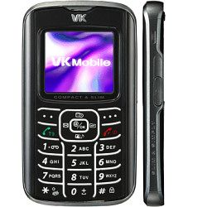
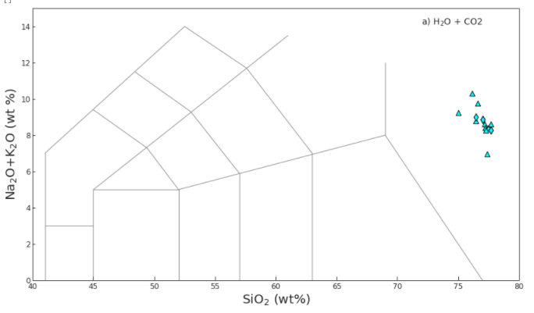
A brief history of solubility modelling: 2005
2005
Notes:
2005 comes along, Liu does CO2 and H2O experiments on rhyolites.

Slide 27
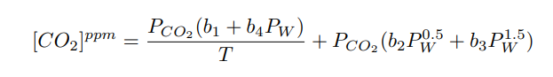
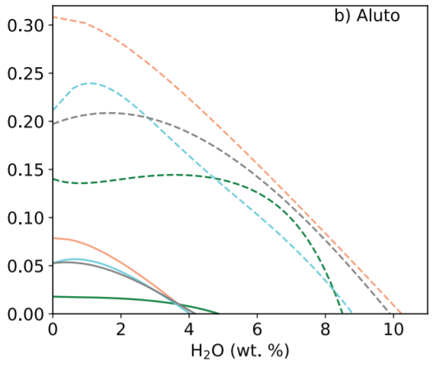
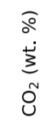
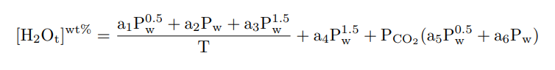
A brief history of solubility modelling: 2005
Fully empirical, no melt composition term
Liu
VolatileCalc
MagmaSat
Papale
Representation of
non-ideality
Notes:
Get mostly empirical model, no melt composition term, T and P dependent, lots of constants. In CO2 model, have Pw terms, so P * fraction of H2O, vice versa, so 1st model showing non-ideality. So instead of considering CO2 soluility, adding H2O, solubility is constantly dropping (as in volatilecalc). Liu predicts as you add a small amount of water, CO2 solubility increases, perhaps because adding OH helps break up the melt, means you can dissolve more carbonate, then starts to drop again as proportion ofH2O in the fluid overwhelms this more subtle event. So isobar gradients change.

Slide 28
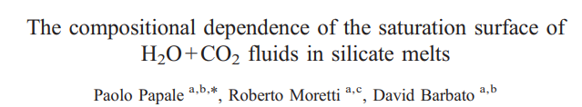
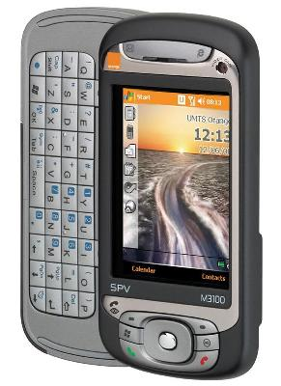
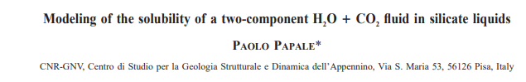
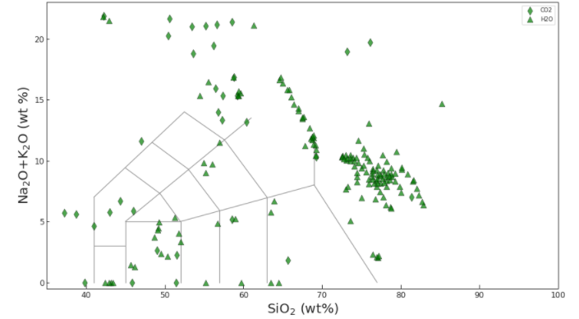
A brief history of solubility modelling: 2006
2006
Building on 1999 and 1997 paper…
Fully thermodynamic
Notes:
2006, papale builds on model released in 1999 and 1997. This is the first model incorporating all of compositional space, alkaline samples, synthetic samples. Fully thermodynamic model, hard to explain exactly how it works.

Slide 29
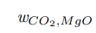


A brief history of solubility modelling: 2006
Melt composition handled through use of interaction terms:
Notes:
Papale handles melt composition in terms of these interaction terms, so WCO2, MgO, how CO2 and MgO interact. But function fo pressure, so adding Mg at one pressure, solubilty goes up, at another pressure, CO2 goes down.
Can look at coefficients, and look at their errors. Errors from model fitting – errors for water small, <10 %, also shows between 1999 and 2006, added a tonne more data, done experimentally, no real change in coefficients for water. Sugets we understand water solubility, new experiments agree with old one. For CO2, massive errors, erroron NA I 146%, error on FeO oefficient, 1500 %. Because in 2006, not many experiments at high Na2O contents, or high MgO contents.
Model also has uniqueness, accounts for FeO and Fe2O3, so sensitive to redox, We’ll come to this later!.

Slide 30



A brief history of solubility modelling: 2012
2012
Notes:
2012 comes along, IaconoMArziano releases model, starts covering high Na and K contents.

Slide 31



A brief history of solubility modelling: 2012
Fully Empirical – Lots of melt composition terms…..
Notes:
Fully empirical, lots of melt composition terms, CO2 has a term for water, so acotuns for non ideality. AI index. Terms for fractions of Mg and Fe, and Na and K, and has term for this NBO/O, so this model for CO2 is sensitive to every oxide. H2O, bit simpler, only NBO/O term.

Slide 32



A brief history of solubility modelling: 2014
2014
Notes:
Shishkina, even more TAS space.

Slide 33



A brief history of solubility modelling: 2014
Fully Empirical – come-back of 1997-esq Pi term…
Notes:
Very simple model vs. Iacono, has a Pi star term like Dixon, instead of adding fractions, Shishkina divides through. Only effect of melt composition for H2O is Na and K.

Slide 34


A brief history of solubility modelling: 2015
2015
Notes:
2015 – monster of solubility models, really filling in TAS diagram.

Slide 35


A brief history of solubility modelling: 2015
Fully Thermodynamic…
Aka “MagmaSat”
*Speciation!
Notes:
Similar to Papale in that it has these melt interaction terms, Magmasat tackes into account speciation. Has molecular CO2 and carbonate ion. Can better account for fact in basalts – basaltic andesites, have carbonate, as move to rhyolites, move to CO2 as molecular CO2. Errors as a result of splitting it,

Slide 36

Example 2: Single sample calculations: Calc dissolved volatiles, calculate saturation pressures,
Compare multiple models (simple)

Slide 37


Assess if solubility models are different
Iacono-Marziano
Papale
Papale
Volatile-Calc Basalt
Shishkina
Moore
MagmaSat
Notes:
Briefly discuss how you can make these figures for a range of P and T, at a specific combination to asses this.

Slide 38

Why is Dixon so often different?
Notes:
Chat through why Dixon is a disaster.

Slide 39
Why is Dixon so different?
Notes:
Chat through why Dixon is a disaster.

Slide 40

Why is Dixon so different?
Notes:
Chat through why Dixon is a disaster.

Slide 41
Example 3: Batch Calculations: Cassidy melt inclusions + Isobar intro

Slide 42

Assessing differences using CDF plots
Notes:
Lets look at all the different models – And see it’s the same problem as for lots of other things.

Slide 43


Evaluating differences using Isobars
CO₂ solubility matters most
H₂O solubility matters most
Notes:
Simon – Can you build on the Sat P calcs I already have to show IaconoMArziano as well? Simon, this might be a good place to get them to start drawing isobars for different models…. Is it worth getting them to draw 1 isobar for one MI, for Mamasat vs. IaconoMarziano. Allows you to see Iacono completely messin up for both H2O and CO2.

Slide 44

Assessing calibration range

Slide 45



Assessing calibration range example 2:

Slide 46

Calibration datasets matter!
High CO2 solubility
Low CO2 solubility
Put zoom
box here!

Slide 47

Calibration datasets matter!
l$n\left[{CO}_{2}\right]=…−17.1∗ X_{MgO+FeO}$
Underestimate
CO2 solubility
Only Shishkina + MagmaSat
are calibrated for
high MgO melts!
Put zoom
box here!

Slide 48
Isobar plots
Represents solubility at a single T for a single melt composition
Ruth et al. 2018

Slide 49




Isobar plots
Iddon and Edmonds, (2020)

Slide 50


Limitations of isobar plots
Iddon and Edmonds, (2020)
Wieser et al. (2021)

Slide 51

Example 4: Degassing calculations

Slide 52
Sensitivity testing uncertain parameters
Sources of uncertainty in Sat P calculations:
Entrapment temperature:
* Always extrapolating, normally down T
2) Diffusive H2O loss
3) CO2 loss to a vapour bubble
4) Major element changes during PEC
5) Other volatile species (E.g., S, Si at higher pressures)
Notes:
Basically saying in a melt inculsion study,these are the things we don’t know.

Slide 53


How much does CO₂ matter?
Geiger et al. 2018
Example 1 : Plagioclase Hygrometry

Slide 54

How much does CO₂ matter?
Ruth and Costa, 2021
Example 1 : Plagioclase Hygrometry

Slide 55

How much does CO₂ matter?
Example 1 : Vapour bubbles
Moore et al. 2015

Slide 56
Example 5: Playing around with adding CO2

Slide 57
Conclusion
Run calculations for >>1 model
If similar, yay! Model choice doesn’t matter too much
Look very closely at calibration dataset, available experiments formulation etc.
Cause of discrepancy may well be obvious (e.g., andesites)
Evaluate sensitivity to other parameters
Likely in well constrained region of space
If different….
Be honest!

Slide 58
Other slides if have extra time (doubt it)

Slide 59

Papale problems….

Slide 60

Temperature sensitivity for basalts
Say 100 ppm CO2, 5 wt% H2O
No consensus as to temperature sensitivity. But not that big a deal (probably 5-10% in most circumstances)

Slide 61


Temperature sensitivity for rhyolites
Say 100 ppm CO2, 6 wt% H2O,
Mono Craters Rhyolite
No consensus as to temperature sensitivity. Papale and VolatileCalc-Rhyolite EXTREMELY SENSITIVE

Slide 62

Temperature sensitivity for andesites
Comparison to experiments of Botcharnikov et al. (2006)

Slide 63
Sensitivity to diffusive H2O-loss
Sensitivity testing for 3 different CO2 contents….
Low P – 200 ppm CO2
Scenario 1: MORB/OIB-related water loss
Medium P – 1000 ppm CO2
1.5 wt%
0 wt%
Scenario 2: arc-related water loss
High P – 3000 ppm CO2
6 wt%
0 wt%

Slide 64

Sensitivity to diffusive H2O-loss
Scenario 1: MORB/OIB-related water loss
* Less important that differences between models (except at very lowest pressures)

Slide 65

Sensitivity to diffusive H2O-loss
Scenario 2: Arc-related water loss
* Much more important than model choice at low pressures, comparable at lower crustal conditions….

